Slide 1
Paxos Algorithm
CSC 6220
Wasfi Momen
12/6/18

Slide 2
Overview
Background on Paxos Algorithms
Research on Paxos Algorithms
Why Paxos?
Paxos Explanation
Implementation of Paxos
Conclusion

Slide 3
Research on Paxos Algorithms
Paxos first came onto the scene in 1990 with Leslie Lamport, a researcher in distributed algorithms and creator of LaTeX.
The paper title was “The Part-Time Parliament” publish in ACM 1998.
Aim was to discover a method of creating distributed systems that were generalized enough to not need exceptions for multiple states.
Most other research is theoretical; mainly focus on improvements to the algorithm or different forms combining Paxos with other topics
Fast Paxos, Generalized Paxos, Byzantine Paxos
Used in many big solutions like Google BigTable, Apache Zookeeper, Cassandra
Chances are that any DB software will support a form of Paxos.
Google Paper: “Paxos Made Live”
Notes:
80s (like everything) had a lot of development in distributed systems development.
Leslie made this paper in response to Echo, a fault-tolerant system
Follows the story of the Greek island of Paxos not wanting leaders, so they elect leaders over time
Received many remarks, many of them “huh?”
Fast Paxos aims to eliminate messages, Byzantine eliminates false processors

Slide 4
Why Paxos?
Still relevant in today’s distributed world, new implementations of Paxos happen with every new paper published.
Paxos focuses on the data transferred being delivered, not the processors doing it.
Potential solution for problems that require consensus and distribution in potentially low processor/user environments.
Educational uses
Notes:
Blockchain is CBC so it has a fixed amount it can send, scalability issues.
Paxos focuses more on the data transferred, can be any size. However, security issues are prevalent.
Years of papers published 2004, 2009, 2010

Slide 5
Explanation of Paxos
Paxos is a distributed, peer-to-peer consensus algorithm that tries to achieve consensus with three basic ideas.
Paxos uses a ledger of suggestions to keep track of proposed Messages.
Proposers: Any peer can propose a Message to be accepted. This Message is tagged with the Proposer’s unique id and a unique, sequential id for the Message to be proposed.
Acceptors: Any peer can accept Messages and then either choose to accept or not accept the value. They send the Proposer(s) a Message with their answer.
Learners: Proposers play the role of the learner to see if consensus has been reached. They track the majority in the quorum.
Consensus is reached once a set majority limit of peers come to the same value conclusion.
Notes:
- Don’t actually need learners. Consensus is reached anyways.

Slide 6
Explanation of Paxos
Now, there are asterisks* to be placed everywhere…
If enough Acceptors reject a value, the Message is rejected from the network. The Proposer can then issue the same Message, but it must contain a higher number Message id.
Proposer and Acceptor are interchangeable, peers can actually propose while working on another Message, even overriding the original Proposer. However, consensus will be reached due to the top point, but the case of rejecting the smaller network will mean multiple round trips to make consensus.
Values of Messages may not be transmitted to all peers.
Other implementations of Paxos address these problems.
Notes:
- Can use Nacks

Slide 7
Example
Three nodes A,B,C, D. Maximum to reach consensus is 2.
A proposes Message(2, “A+”)
B, C, D receive. Only B accepts.
Message approval failed. Await next message.
A proposes Message(3, “A+”). D cannot receive due to Windows updating…
This time B, C accept the message. Consensus was reached.
D reconnects. If it tries to propose Message(2, “A+”) it will be rejected. It can try to send another message like Message(4, “B”).

Slide 8
Implementation of Paxos
Recent innovations of the Smart Grid have opened new distributed problems, particularly with privacy.
Smart meter readings can be easily read and understood to be individual actions within a building.
Considering privacy considerations in the Smart Grid is part of NIST’s Smart Grid Framework which is currently being developed.

Slide 9
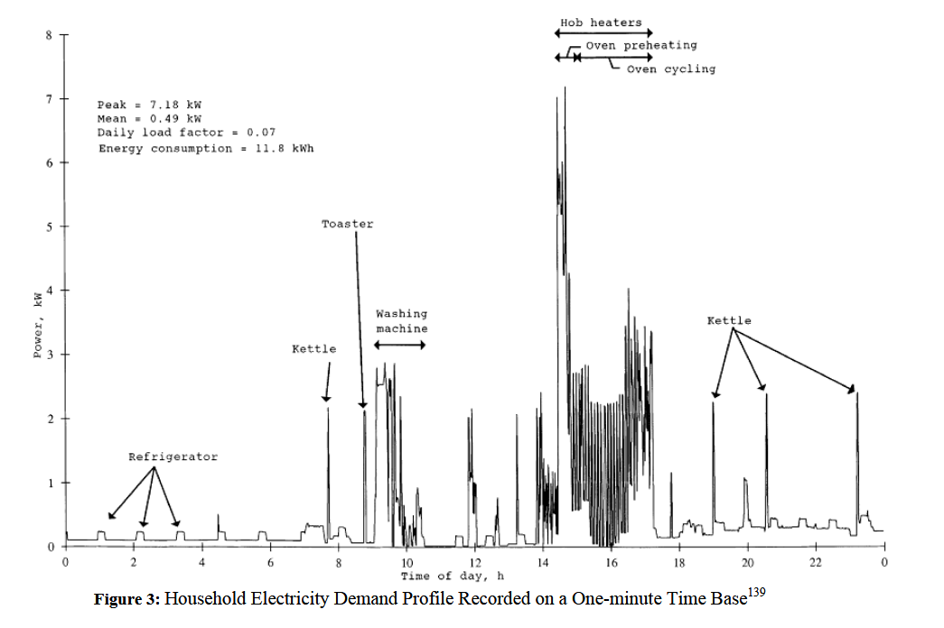
Notes:
- For full implementation will attempt to simulate a substation using available tools, however online tools are picky.

Slide 10
Implementation of Paxos
We implement a privacy Paxos algorithm by issuing a proposed privacy value to an untrusted acceptor to which consensus can be reached.
Once consensus is reached, we can transmit privacy data to Proposers.
We use the definition of privacy parameter as differential privacy. The ε value between the continuous domain of [-1, 1] is our value to be proposed and accepted.

Slide 11
Implementation of Paxos
In our code, we have our Paxos implementation as follows:
SubStation: is the proposer of the group. Picks privacy values and then broadcasts to all acceptors to propose values.
SmartMeter: is the acceptor of the group. Rejects and accepts privacy values based on their chosen value.
MeterMessenger: Handles messages between the two groups.
Notes:
- Using pseudorandom with seed for values, except substation value.

Slide 12
Implementation of Paxos
Can this actually work in real life?
…Maybe. Privacy works a little differently than just accepting and proposing values. Will need to add Paxos and Differential Privacy together.
Chen et al. explains a voting process to fetter out malicious meters for a false data injection attack
Uses similar emulation of state machines using state estimation
Calculate a trusted, configurable space for smart meters
Does the calculations after data collection, therefore neglecting privacy.

Slide 13
Conclusion
Paxos is still relevant to the field of distributed computing.
We can show consensus being used in modern-day applications.
Understanding Paxos is still a topic that can be taught relatively simple and expanded upon via more and more published papers.
Consensus can be found in more than one algorithm.

Slide 14
Bibliography
Chandra, Tushar D., Robert Griesemer, and Joshua Redstone. "Paxos made live: an engineering perspective." Proceedings of the twenty-sixth annual ACM symposium on Principles of distributed computing. ACM, 2007.
Chen, P., Yang, S., McCann J., et al. (2018). Detection of false data injection attacks in smart-grid systems - IEEE Journals & Magazine.
Leslie Lamport, "Paxos Made Simple", ACM SIGACT News (Distributed Computing Column) 32, 4 (Whole Number 121, December 2001), December 2001
T. F. Rezende, P. Sutra, R. Q. Saramago, L. Camargos, "On Making Generalized Paxos Practical", 2017 IEEE 31st International Conference on Advanced Information Networking and Applications (AINA), March 2017
Tom Cocagne, Essential Paxos, January 2013, Github Repository, https://github.com/cocagne/paxos

